Slide 1

Outage Prediction
Using weather data to predict outage risk and assist resident preparation
Joanna Huang, Kalvin Kao, Justin Plumley
December 19, 2017
Notes:
Kalvin:
Hey everyone, our team is Joanna, Justin, and myself, and our application predicts the occurrence of power outages using weather data.

Slide 2
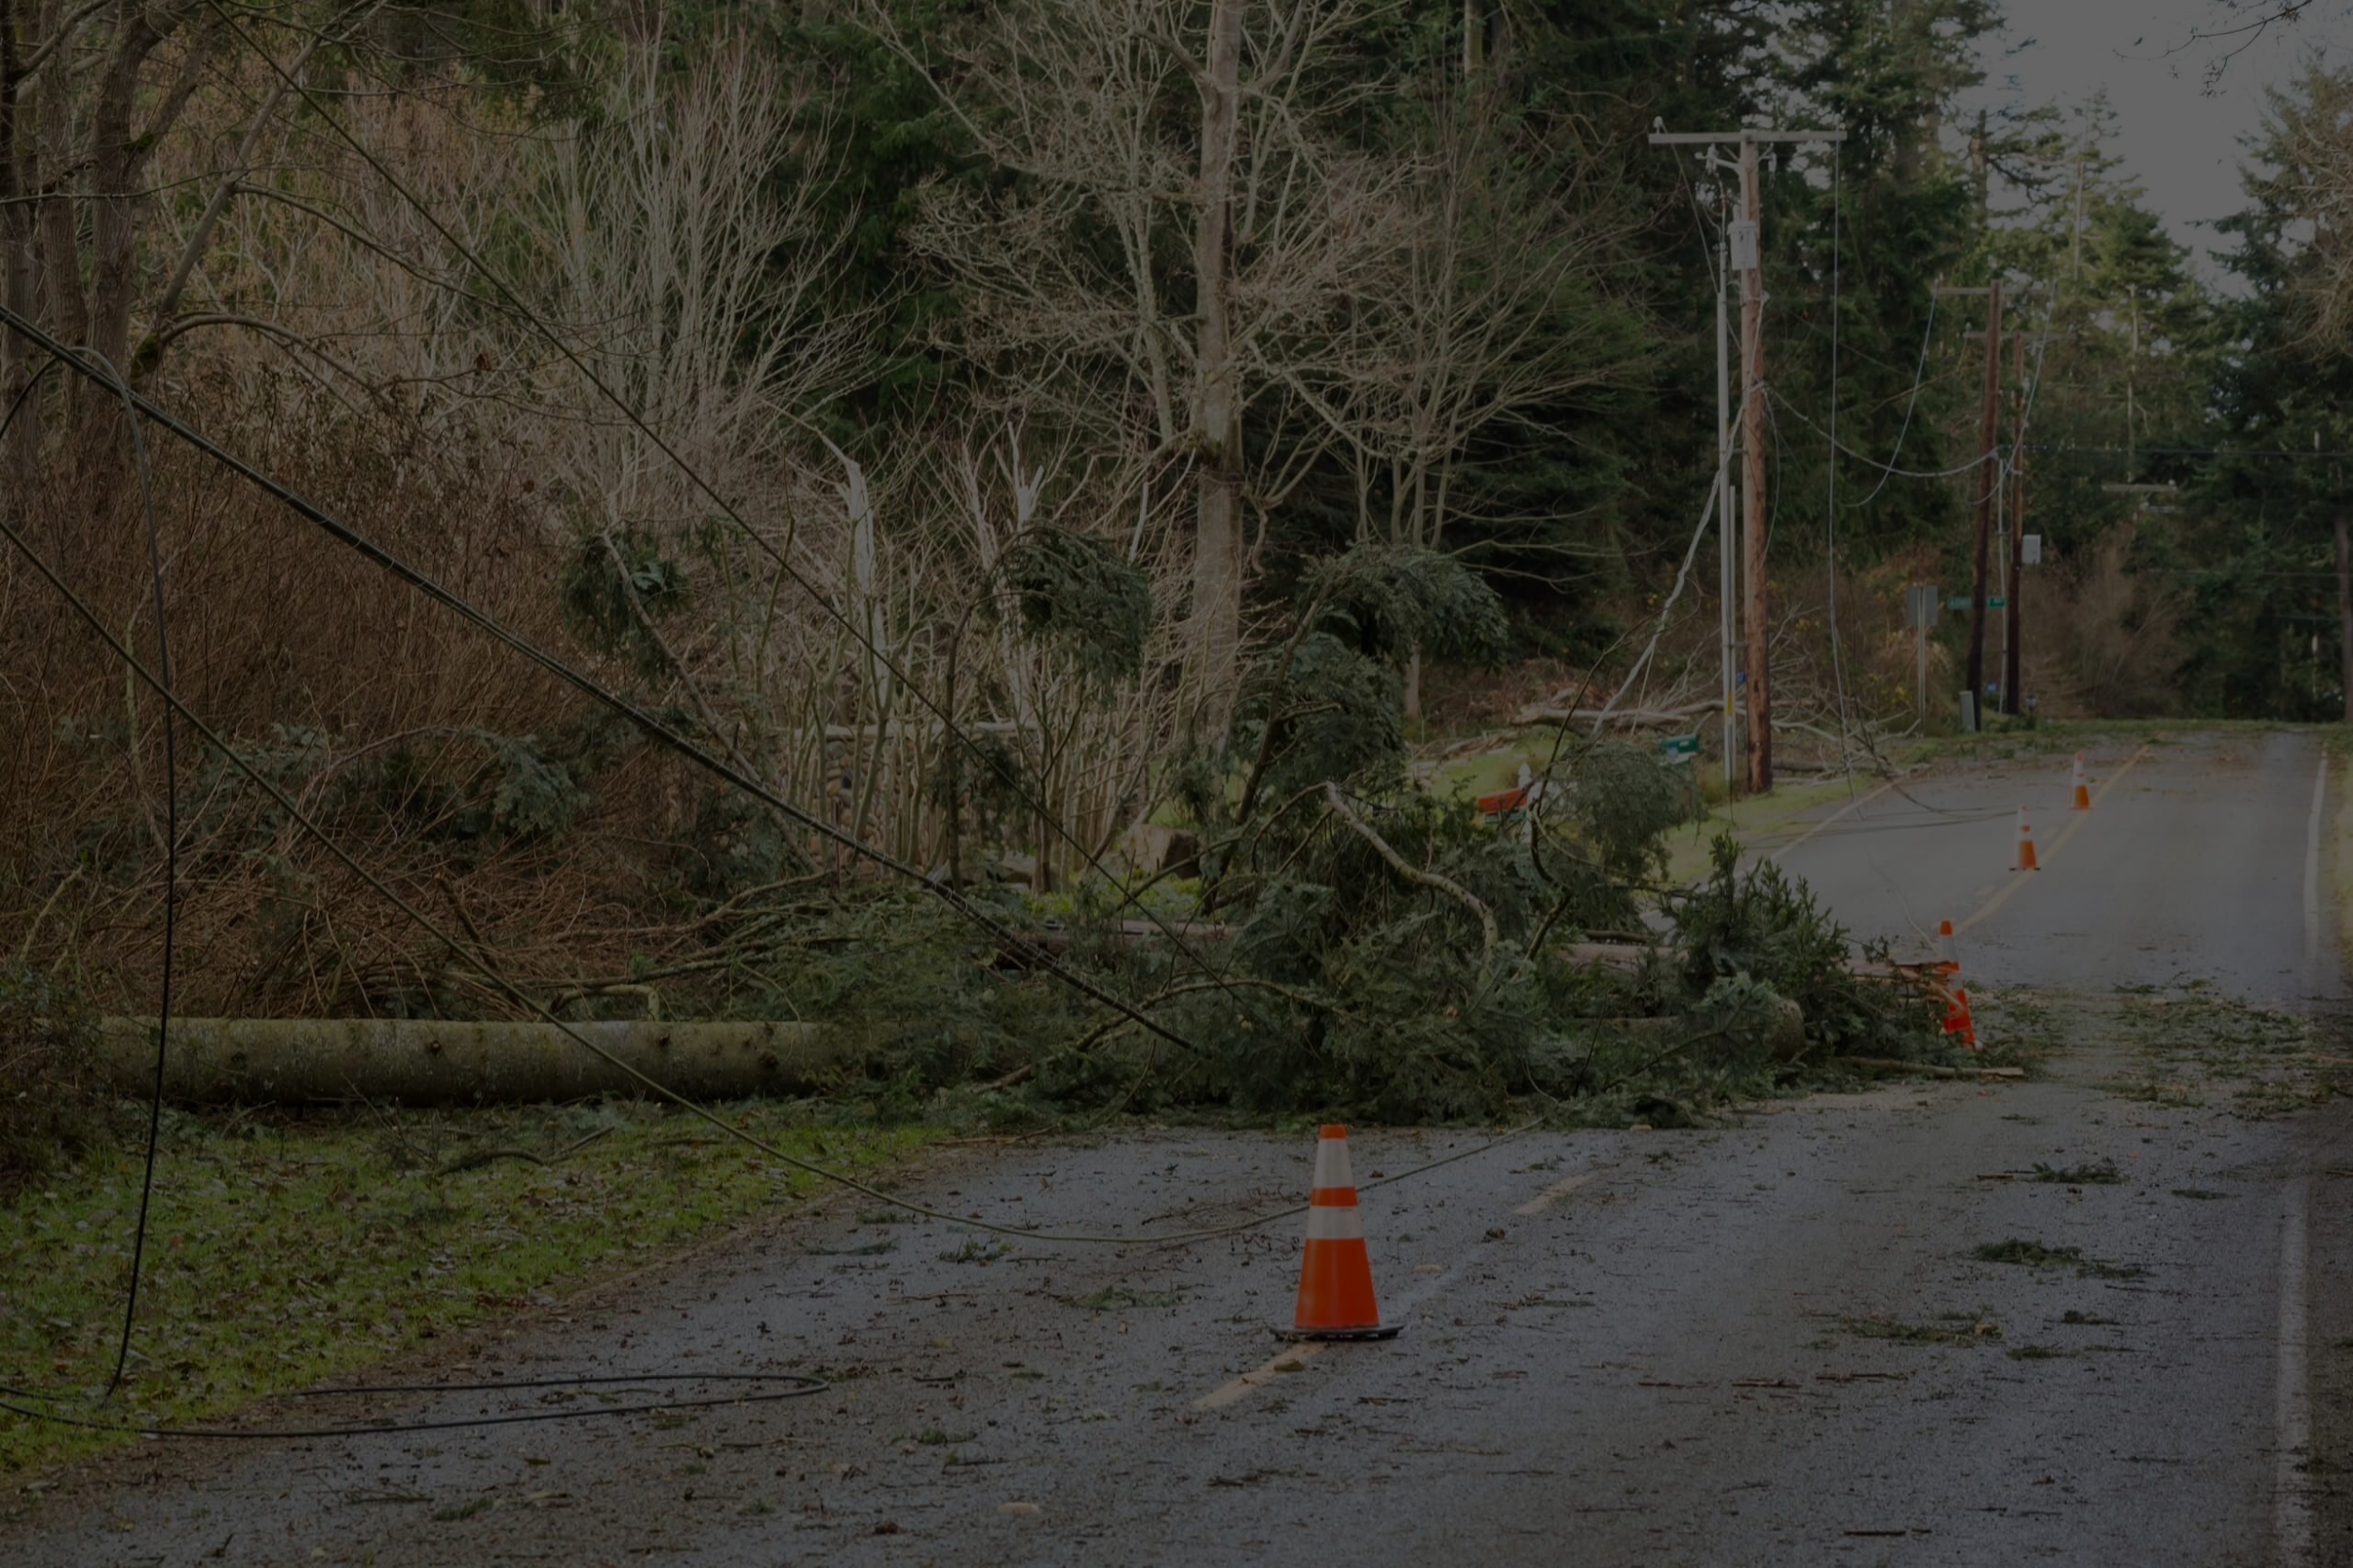
Background:
Power outages due to downed power lines are a frequent occurrence in the US
Extreme weather events result in economic, social, and physical disruptions
Aging power grid
Potential cost of $150 billion per year
Notes:
Kalvin:
Many other developed countries are moving to buried power lines, but here in the US, we still depend on above-ground power lines. And as a result, we frequently have power outages due to downed power lines-- according to the Edison Electric Institute, 70% of power outages in the U.S. are weather related (http://www.dieselserviceandsupply.com/Causes_of_Power_Failures.aspx). Specific causes include a combination of local wind, tree density, and soil conditions, but in any case, power outages have economic and social consequences that include inconvenience and the loss of critical lifeline systems during a disaster.
Just to give an example, customers in Japan averaged 4 minutes of downtime every year, while customers in the Pacific Northwest averaged about 214 minutes of downtime. And according to the Department of Energy, these power outages could be costing companies as much as $150 billion per year (http://www.dieselserviceandsupply.com/blog/March-2017/US-Power-Outage-Statistics.aspx).
Another factor in the frequency of power outages in the US is the aging power grid. The U.S. electric grid loses power 285 percent more often than in 1984 (http://www.ibtimes.com/aging-us-power-grid-blacks-out-more-any-other-developed-nation-1631086).

Slide 3


Project objective:
Use weather and power datasets to predict outages and their potential magnitude to inform residents and assist in preparation
Notes:
Kalvin:
Our application seeks to assist with this problem area by using historical weather, historical power outage, and weather forecast data to predict when outages will occur due to bad weather.

Slide 4
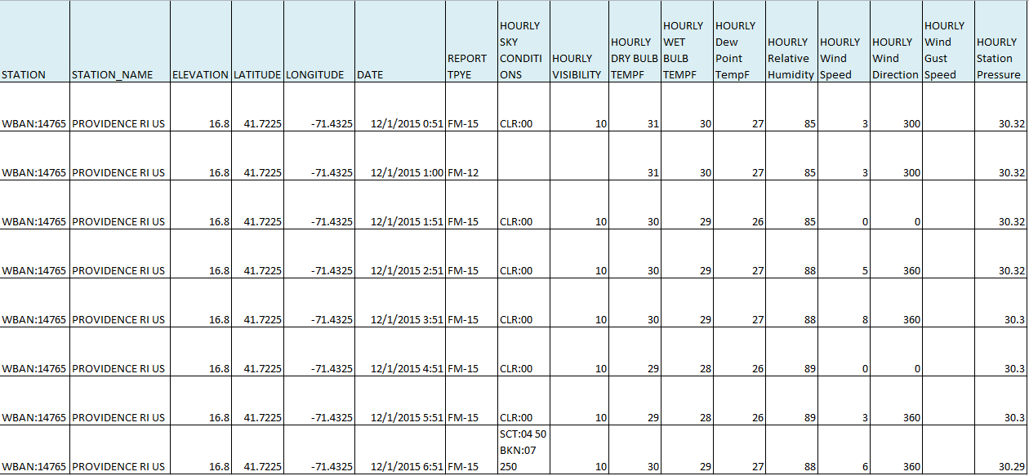
Acquisition and Organization of Information for Analytics
NOAA
(National Oceanic and Atmospheric Administration)
Provides weather history over a long period of time and / or locations
Data fields: sky conditions, visibility, temperature, humidity, wind speed, pressure
Data size: up to 13,000+ observations/year (per city)
https://www.ncdc.noaa.gov/
Notes:
Kalvin:
NOAA - variety of services with different frequency, but we are interested in daily (and in the future potentially hourly) information. - L
Here’s an example of the historical weather data the application currently uses to learn on. This is local climatology data from the National Centers for Environmental Information (part of the National Oceanic and Atmospheric Administration), and this example comes from Rhode Island, where nasty New England weather creates a lot of opportunity to correlate weather and power outages. It is semistructured but high quality data about daily averages and extremes, as well as hourly observations, for a particular weather station, and some example fields are the temperature, humidity, and windspeed. This type of data is available starting in 2005 across 1000 weather stations in the US, and with up to 13,000 observations per year, per station, we consider this large data.

Slide 5
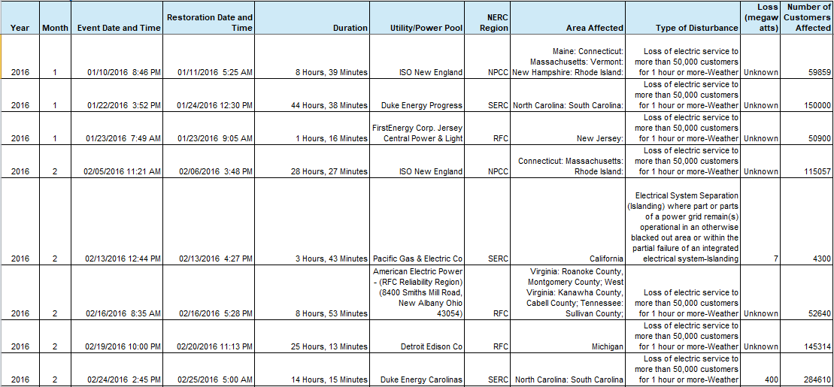
Acquisition and Organization of Information for Analytics
EIA Electric Power
Major Disturbances and Unusual Occurrences, Year-to-Date 2016
Data fields: Year, Month, Event Date and Time, Restoration Date and Time, Duration, Utility/Power Pool, NERC Region, Area Affected, Type of Disturbance, Loss (megawatts), Number of Customers Affected
Data size: 50-100 observations a year
https://www.eia.gov/electricity/monthly/epm_table_grapher.php?t=epmt_b_1
Notes:
Kalvin:
EIA - this is a low volume dataset with power outage information. Reports available annually or monthly. - XS
Now here’s an example of the power outage data the application learns on. This is an annual report of the major disturbances in power across the entire nation, and includes information such as the time, date, severity, and general location of power outages. It is less structured and slightly lower quality than the local climatology data, which we could tell was meant for querying, whereas this data is intended to be more of a report. Since there are only about 100 observations per year for the entire country, we consider this data to be extra-small.

Slide 6
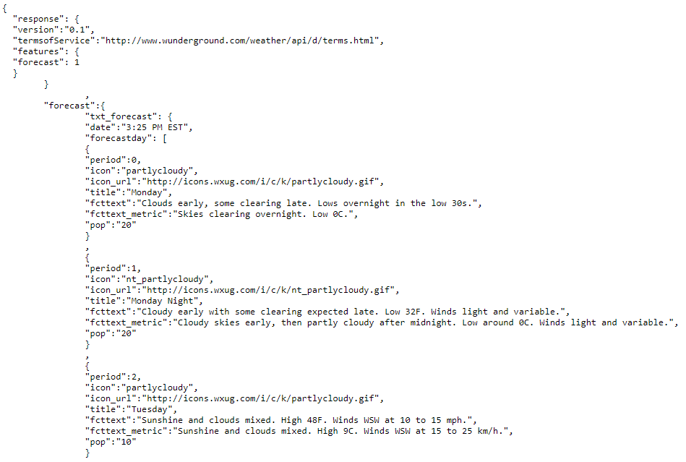
Acquisition and Organization of Information for Analytics
Weather Underground
Hourly forecasts accessed via API
Data fields: location, observation time, weather description, temperature, humidity, wind (dir, mph, pressure), precipitation)
Data size: Depends on number of cities
http://www.wunderground.com/weather/api/
Notes:
Kalvin:
W.U. - hourly forecast available. License limits calls per day and per hour with one call per site, though cost is very low to scale. - S
And finally, this is an example of the weather forecast data that we get from Weather Underground, which includes local weather details like temperature, humidity, wind speed, and precipitation over the next three days. The JSON format makes it highly structured, and it is generally high quality, with some occasionally missing fields. With over 250,000 weather stations, the size of this data depends on the number of cities or stations we choose for the application, but since the API license limits us to one call per hour per station, we consider it to be small sized data.

Slide 7

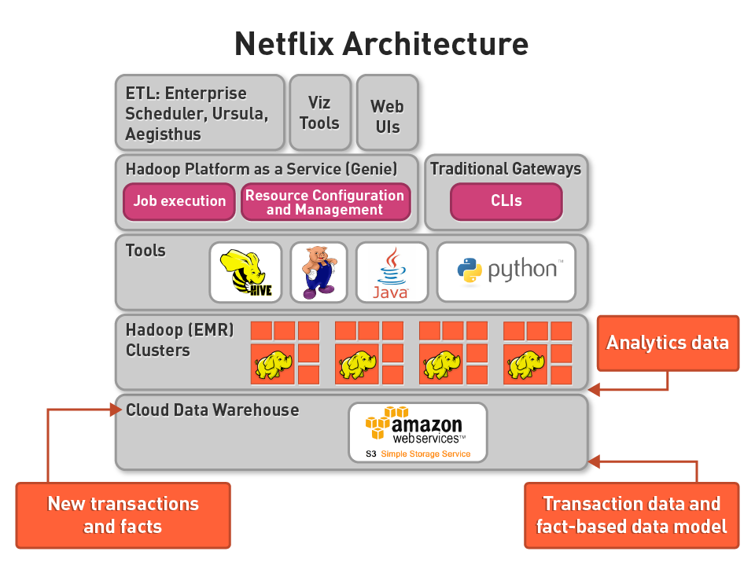
Future Architecture
Architecture: Netflix
One data warehouse for restoring predictive analyses
Storage: HDFS
Small, structured, semi-complete data
Low latency, low quality, and basic query requirements
Scales out
Processing: Apache Spark-SQL
MLlib, RDDs, pySpark
Notes:
Kalvin:
Here is the storage and retrieval architecture that we envision for a full-scale out of the application, which is based on the Netflix Architecture we learned about in class. It’s centered around the idea that we would use one data warehouse to which we can push back the results of our machine learning. HDFS for storage suits the type of small, structured, semi-complete data we have, scales out by adding clusters, and fulfills our querying needs. And Apache Spark-SQL, with its MLlib library and resilient distributed data structures would support larger machine learning tasks. As Joanna will mention, we are currently processing in memory with Spark and sci-kit learn because of the small size of the data. So an example of the full scale out solution could be Hadoop for storage, Spark on top of that for processing, with Spark MLlib for machine learning and Spark for Streaming, and finally Tableau, which has a scaleout server, for visualization.
No Scale Out • Storage layer – PostgreSQL, etc. • Processing layer – SQL, Python, etc. • Machine Learning – Python with Scikit-learn, R, etc. • Streaming media – Python single threaded API, etc. • Data Visualization – freebee as Tableau has a scale out server
Spark is scale out for processing, right now we’re dealing with everything in memory because of the small size of data but as we scale out, we’re store this across HDFS as we can add clusters to keep distributing data. For scale-out, we can build Spark on HDFS for data storage
Scikit-learn replace with MLlib to build classifier
Full scale out • Storage layer – Hive, Redshift, etc. • Processing layer – Spark, Hadoop MapReduce, etc. • Machine Learning – Spark MLlib, Mahout, etc. • Streaming Media – Storm, Heron, Spark Streaming, Kafka, etc. • Data Visualization – freebee as Tableau has a scale out server!

Slide 8










Pilot Architecture
Storage Layer
Processing Layer
Streaming Layer
Serving Layer
Notes:
Joanna:
For the pilot architecture we’ve set up for today, we’re using Amazon Web Services to store our historical weather and outage data. For processing, we’re using Apache Spark within a conda environment to access python libraries such as scikit learn for machine learning. After our input data is processed, the results are saved using Hive, which we will describe in more detail later. In terms of streaming, we are using cron, to pull our forecast data hourly from the weather underground api and run our script for updated outage predictions. Lastly, for final reporting and visualizations, we are using Tableau as the final serving layer.

Slide 9
Process: Pilot
LEARNING
Put EIA
EIA
Process EIA
Join Weather and Outage
Train Model
Put NOAA
NOAA
Process NOAA
PREDICTION
Call Forecast
WU
Model
Predictions
Tableau
Notes:
Joanna:
Version 1: Now we’ll take you through our pilot workflow in a little more detail. Our pilot has two layers for learning and for prediction. In the learning layer, we load the historical weather and outage data for a given city, in this pilot it’s Providence, RI for the year of 2016. Particularly, we chose the weather characteristics of windspeed, maxTemp and minTemp to predict on since our forecast data also had the same data available. We then process and feed this as training data for our logistic regression model, and predict outage results on the forecast test data we pull from weather underground. Along with state and city information, we save a final table using Hive that shows the probability of outage in the next three days.
Version 2: Now we’ll take you through our pilot workflow in detail. Our pilot has two layers for learning and for prediction. In the learning layer, we load csvs of the historical weather data and outage data for Providence, RI from 2016 into Spark RDDs. Then we filter out outage dates that included our first state, Rhode Island, and columns of interest from the weather data, namely windspeed, max Temp and min Temp and create temporary Spark SQL tables. We then join the weather and outage tables by date such that there is a binary indicator for whether there was a outage on that day.
Next, we collect all the data to create a train data matrix of features we want to learn on and a train labels array which contains the list of outcomes to learn on.
Then we go into our second layer of prediction. We call the weather underground api for 3 days forecast information and create a test_data matrix of features to predict on. We feed these arrays into logistic regression model, fit the model according to the given training data, and predict outage results on the forecast test_data. We also calculate the probability of outage for each day.
After stacking all the arrays, along with state and city information, we save a final table using Hive that shows the probability of outage in the next three days. Then we connect our server with Tableau for the final visualizations.

Slide 10
Demo
Notes:
Joanna:

Slide 11
Process: Next Iteration
Scrape EIA
EIA
Process EIA
Join Historical
Train Models
FTP NOAA
NOAA
Process NOAA
Call Forecast
WU
Models
Predictions
Tableau
Notes:
Justin:
Our pilot design is such that the fundamental workflow remains intact as we build out a scalable production process. This is very close to the pilot.
Steps with a border in yellow essentially only have volume increases. Steps in red would benefit from updates:
EIA is low volume with only periodic updates. Automating the data grab is the only change needed.
A large NOAA dataset (compressed ~3GB) would be pulled and stored in HDFS daily.
Considering volumes, models may be fine still using sci-kit learn, or converting to MLlib for additional scalability

Slide 12

Process: Next Iteration
Live Class Reaction
Scrape EIA
EIA
Process EIA
Join Historical
Train Models
FTP NOAA
NOAA
Process NOAA
Tableau
Call Forecast
WU
Models
Predictions
Data Store
Notes:
Justin:
We have also introduced new serving layers, where the various predictions could be stored in your preferred Data Store, for accessing beyond Business Users’s dashboards.

Slide 13

Process: Next Iteration
Live Class Reaction
Optional Additional Source Processing
Scrape EIA
EIA
Process EIA
Join Historical
Train Models
FTP NOAA
NOAA
Process NOAA
Tableau
Call Forecast
WU
Models
Predictions
Data Store
Notes:
Justin:
This process is also easily amenable to include additional data sources, should we find better source of soil characteristics, say, which is reportedly valuable in prediction.

Slide 14
Process: Next Iteration
Optional Additional Source Processing
Scrape EIA
EIA
Process EIA
Join Historical
Train Models
FTP NOAA
NOAA
Process NOAA
Tableau
Call Forecast
WU
Models
Predictions
Data Store
API Calls
Notes:
Justin:
Also, as we envision potential expansion of service, we could provide a service for API calls to take advantage of either our models or local predictions.

Slide 15
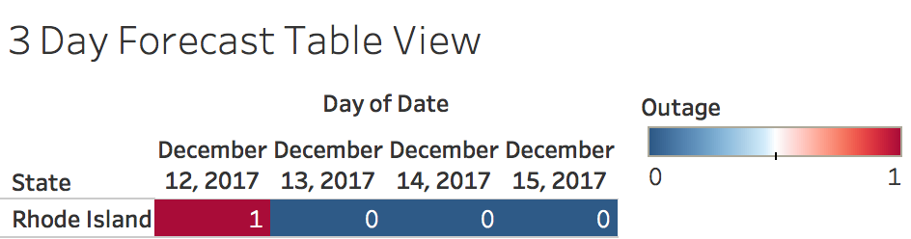
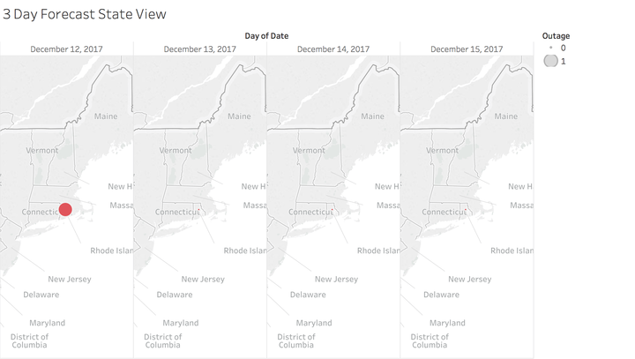
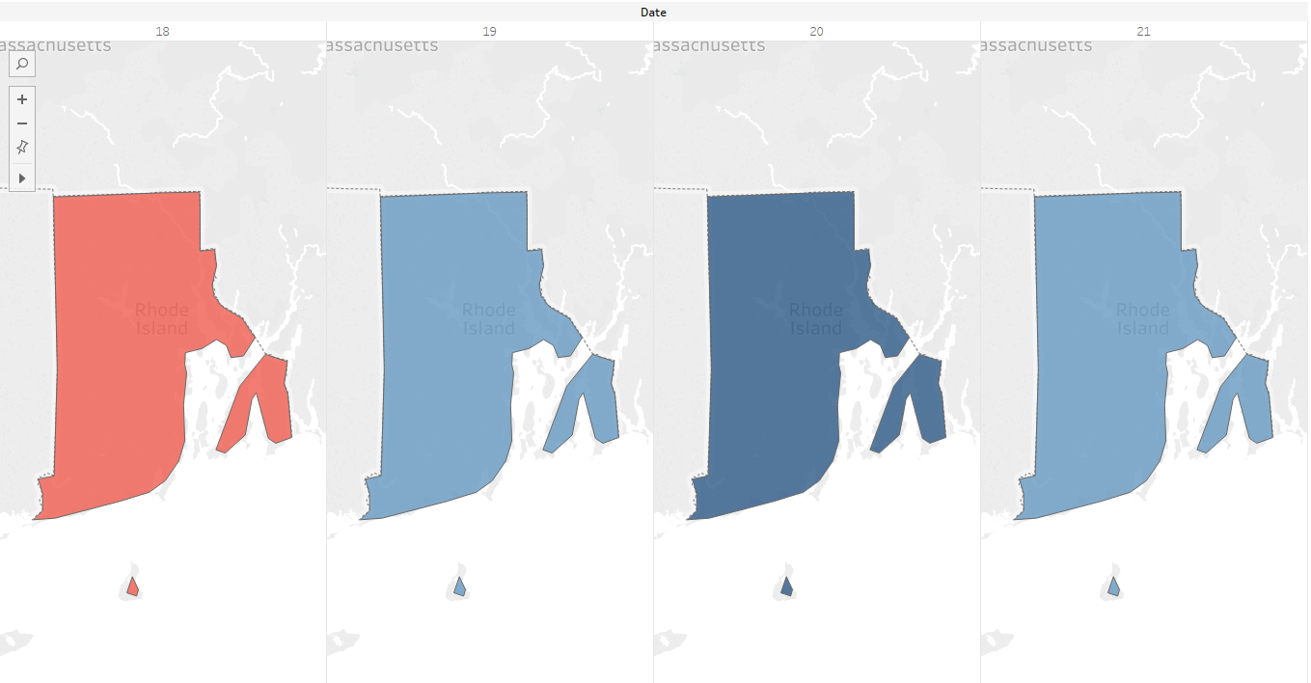
Usage
Local Residents (Public Service)
Direct or through Media Channels
Warning / Preparation
Notes:
Justin:
Originally, our intended end consumers were local residents (either directly or through media channels). They could access readable charts through Tableau server for warning and preparation purposes. Here are some examples for demonstration purposes from our pilot:
Easy to read indicators for a given region
Signals can be provided only when the risk is beyond a certain threshold
Color coding provides an easy way to understand the risk of outage predicted over the forecast period

Slide 16
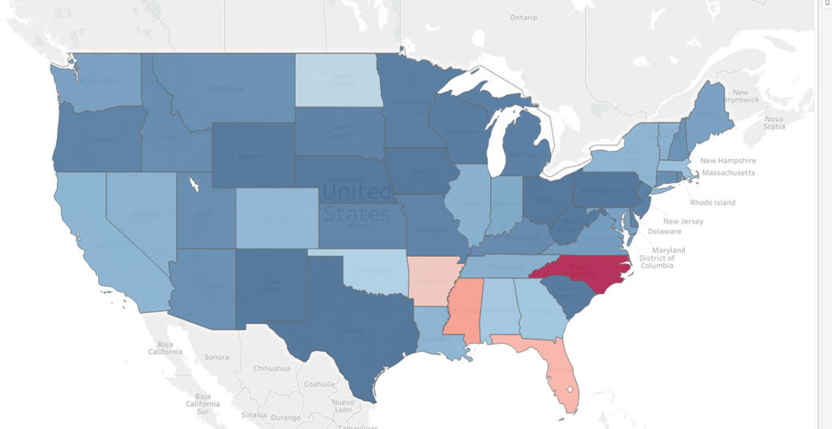
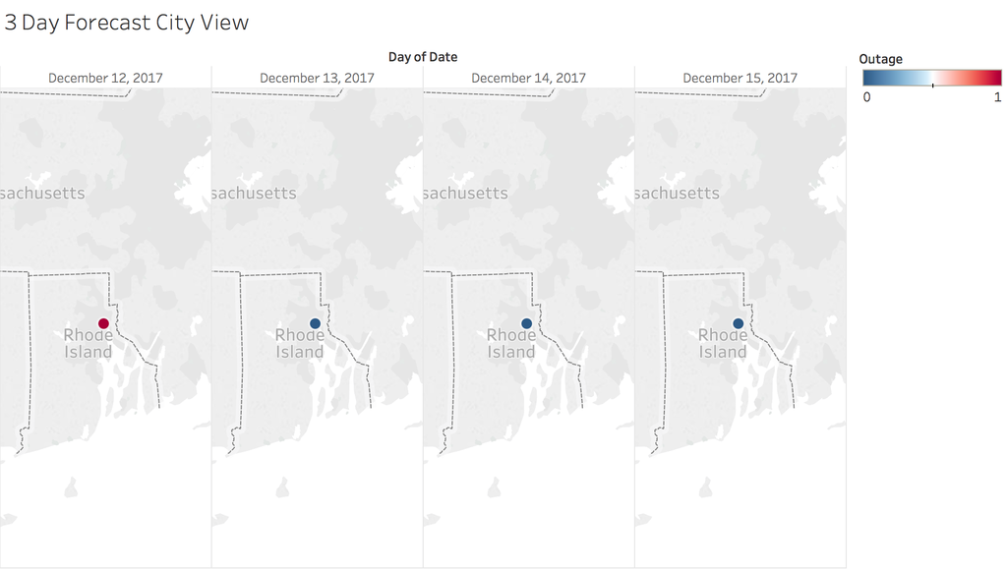
Usage
Utilities
Complement Existing Process (labor, capital costs)
Private Sector
Demand Forecasting
Supply Chain Risk
Notes:
Justin:
We think there are opportunities with other interested parties as well, which may include:
Utilities, for whom we could provide longer forecasts to complement their existing processes aimed at maintaining service levels and reducing additional labor and capital costs. Over time (as we improve models and work to include both wider and more granular data), this could improve regional allocation of service professionals or equipment.
The Private Sector, where Retailers may be interested monitor supply chain risk in potentially affected areas, or enhance demand forecasting predictions (grocer, hardware store, outfitters, etc.) using our forecasts. Other industries may potentially be interested:
Plenty of service companies become impacted by outages, not just utility companies
Insurance companies may be willing to pay for information at more granular regions
Wall Street may use as outages create winners and losers, especially in the short term, as revenues increase for some industries and decrease for others.

Slide 17
Recap
Pilot designed for ease of scaling
Prepared for Volume and Velocity increases
Workstream supports various sources and can support Variety growth
Suggested Developments in the Future
Increase breadth and depth of geographic areas served
Scale parts of solution separately, need-based
Add serving layers
Expand sources -> more predictors
Notes:
Justin:
To recap, we designed the pilot to illustrate the concept and to ease development into a more scaled out version (as necessary).
We are currently pulling in various sources and are prepared for the sources to grow as we may find datasets that improve our prediction (e.g. natural: soil, seismic activity...or man-made: attacks on infrastructure)
We are prepared for both volume and velocity increases as well.
Some suggestions for future development include:
Bringing in other states and stations within states
While enabling a fully scaled out solution is ideal, we suggest prioritizing components to scale. Our expectation is that scaling storage would be early to support more data, though the smaller post-processed datasets being modeled may mean delaying scale-out there may be acceptable in early stages.
Add additional serving layers to provide more value from the service. Some of these options are relatively low cost to develop and could lead to revenue streams.
Expand our sources. If we had the data we wanted:
More precise location information for outages
Precise information about downed power lines

Slide 18
Thank You!

Slide 19
Appendix

Slide 20
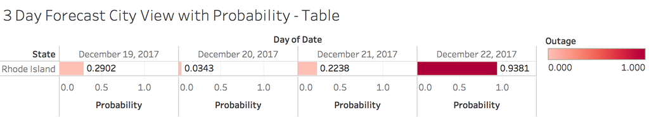
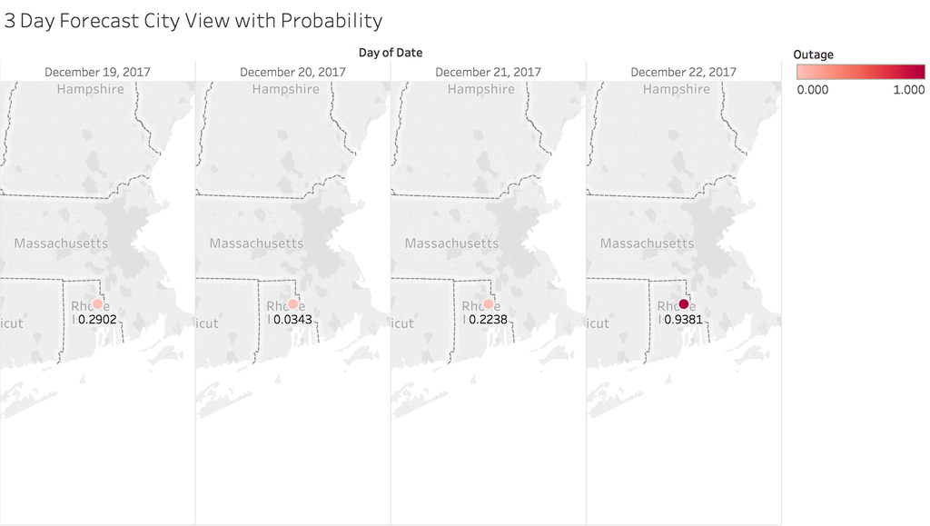
Additional Visualizations

Slide 21
Reference of Previous Work
High-speed winds during a thunderstorm may cause trees around an electric grid to crash into the distribution system feeders causing an outage in that area. This model predicts potential vulnerability to ensure the trees in the most critical areas with the highest risk to be trimmed first.
“Power outages in the distribution system are primarily caused by wind blowing trees and limbs onto power lines,” says Guikema. “Therefore, our model includes a number of different measures of wind, the type of trees, and the soil moisture conditions, which provides a measure of the stability of the soil and the likelihood of a tree being uprooted.”
A group of researchers led by Seth Guikema at the University of Michigan has created a model that predicts the number of power outages “based on wind speed estimates, population density, soil moisture levels, drought indices, and information about trees in each census tract.”

Slide 22
Solution Architecture Draft
Learning Data
Prediction Data
xlsx
RDD
csv
1) query for past outages due to severe weather
2) label historical weather data
csv
RDD
3) teach power outage classifier
4) predict outages based on current forecast
5) surface predictions in viz layer
raw data
json
RDD

